Slide 1

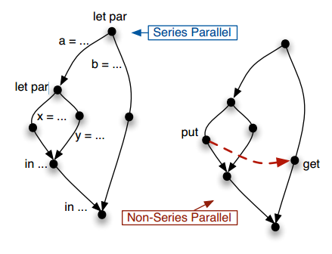
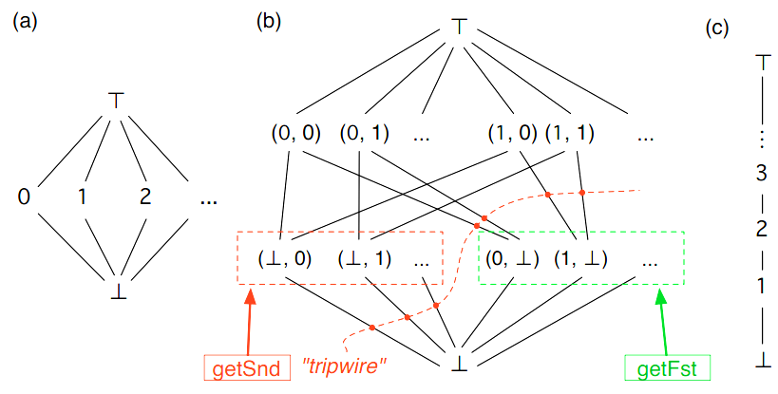
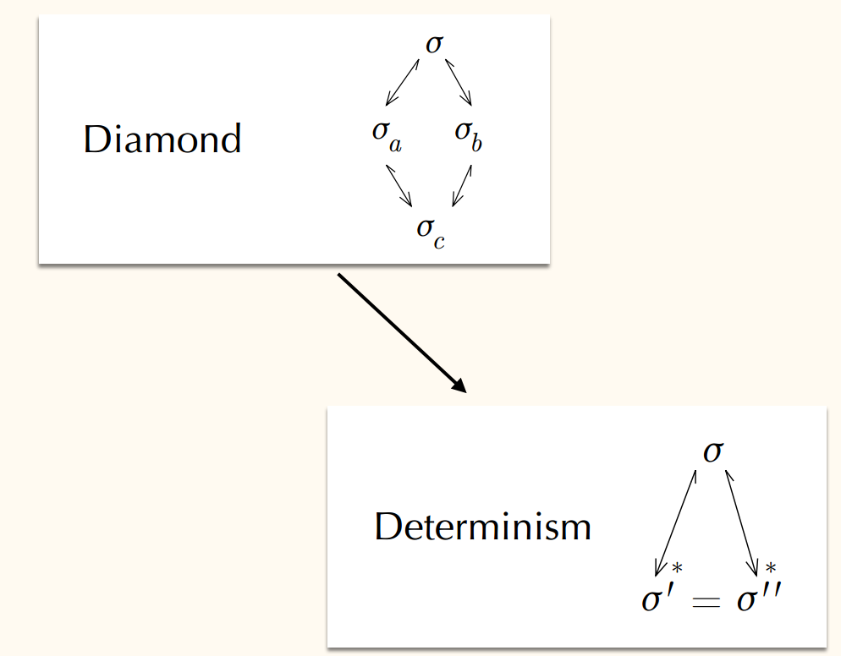

LVars for Parallel Programming
Isaiah Weating & Lindsey Kuper
School of Informatics and Computing - Indiana University
Introduction
The Problem
Parallel programming is a form of computation in which many calculations are carried out simultaneously, operating on the principle that large problems can often be divided into smaller ones, which are then solved concurrently.
Parallel programming with state is hard. blah blah blah blah blah blah
Non Determinism blah blah blah generic definition
It is the interaction of being parallel and keeping state that is dfficult
let par a = ... let par x = ... y = ... in ... b = ... in ...
let par a = ... let par x = ... Put(l) ... y = ... in ... b = ... Get(l) ... in ...
Before I began working on this project, there was already an implementation of the counter lvar, c, that allows the user to put a value in and if you attempted to get a value, it will return true as long as that value doesn’t exceed the max value, the value that was put into the lvar.
Lvar B allows for pairs of values.
Tools Used
Reddex is a programming language used for creating programming languages which is embedded in the racket language
Determinism for λ LVar
Future Work
Info written by Lindsey
various headings..
The problem
Our contribution
Materials and methods should talk about redex anc racket
Future of Project
Contacts
Isaiah Weating --- iweating@indiana.edu
Lindsey Kuper – lkuper@cs.indiana.edu

